Slide 1
Project 1: Food Fighters
Raq Haque
Samantha Kaplan
Yashaswi Puttaswamy
Mohammad Rao

Slide 2
Agenda
Background
Introduction
Hypothesis
Data Cleanup
Analysis/ Findings
Post Mortem
Q+A

Slide 3
Background
New York City Department of Health and Mental Hygiene (DOHMH) conducts unannounced inspections of restaurants at least once a year. Inspectors check for compliance in food handling, food temperature, personal hygiene and vermin control. Each violation of a regulation gets a certain number of points.
Restaurants with a score between 0 and 13 points earn an A.
Restaurants with a score between 14 and 27 points earn a B.
Restaurants with a score between 28 or more earn a C.
Please note that not every restaurant receives one of these letter grades; N was the grade for those restaurants not yet graded, Z was used for a pending grade, and P for grades that were pending after the reopening of a restaurant that had previously been closed down.

Slide 4
Introduction
We wanted to be more aware of our food choices and wanted to investigate any disparities between a restaurant's location and type of cuisine. A couple questions we wanted we asked:
How many restaurants are there in NYC? Where are they most concentrated?
Based on cuisine served, which restaurants had the best grades? The worst?
What the most frequent restaurant chains in New York?
Notes:
Define the core message or hypothesis of your project.
* Describe the questions you asked, and _why_ you asked them
* Describe whether you were able to answer these questions to your satisfaction, and briefly summarize your findings

Slide 5
Hypotheses
H1: There are more restaurants in Manhattan than there are in other boroughs
H2: In low density areas restaurants might have a better score given the assumption that they would be busier due to the lack of competition and higher turnover on food.
H3: Restaurants in busier neighborhoods had better grades, because the staff would have a greater attention to detail in a busier place.
H4: Pricier cuisines would translate to cleaner restaurants, as the increased revenue from the food would drive better restaurant cleanliness.

Slide 6
Data Acquisition
The data is sourced from NYC OpenData site provided by DOHMH New York City Restaurant Inspection.
The dataset provides restaurant inspections, violations, grades and other information for the five boroughs going back to 2010.
The total data size for all NYC boroughs is ~ 400K restaurants.
https://data.cityofnewyork.us/Health/DOHMH-New-York-City-Restaurant-Inspection-Results/43nn-pn8j

Slide 7
Data Cleanup
Excel to clean the and create different pivot tables
This was used as reference sheet as all the pivot tables helped us visualize an output.
Python
In Jupyter Notebook we used Pandas to drop the columns that weren’t necessary in the analysis
Dataframes were then created based on how to best answer our questions
The dataframes were then used to create graphs to visualize the data
Notes:
There are three types of violations -
Critical

Slide 8
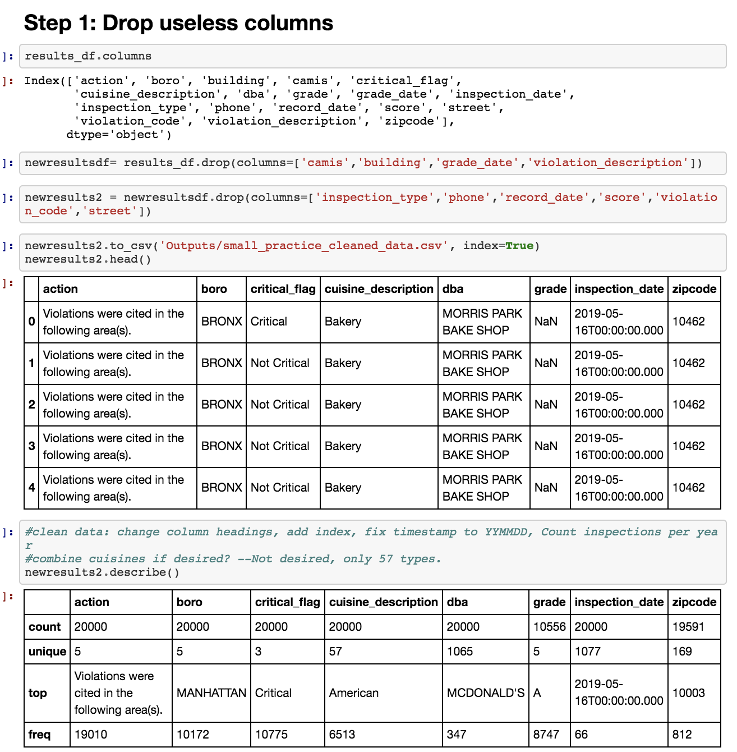

Slide 9
Analysis/Visualization
We used a combination of bar graphs, pie charts, scatter plots and heat maps to visualize the spread of restaurants and their status across NYC

Slide 10
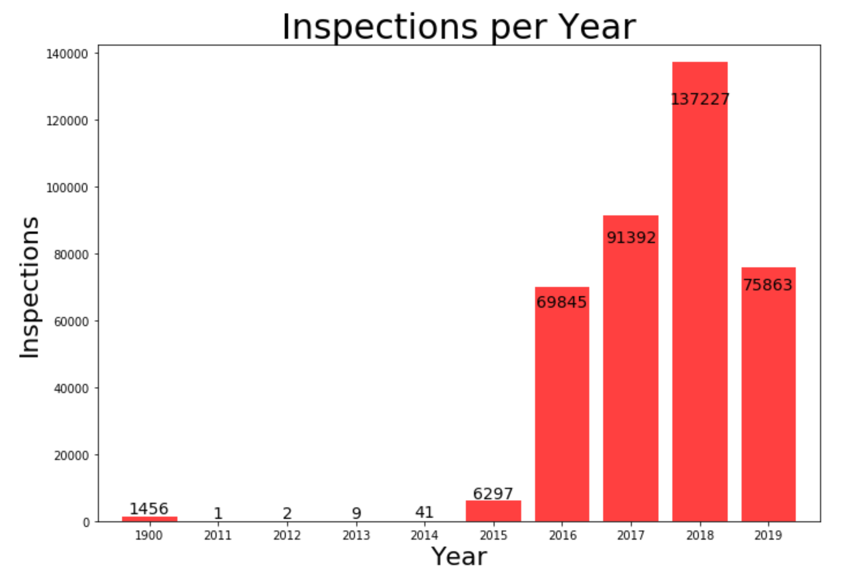
Inspections Per Year
Notes:
See how many inspections each year- is there a trend over time?

Slide 11
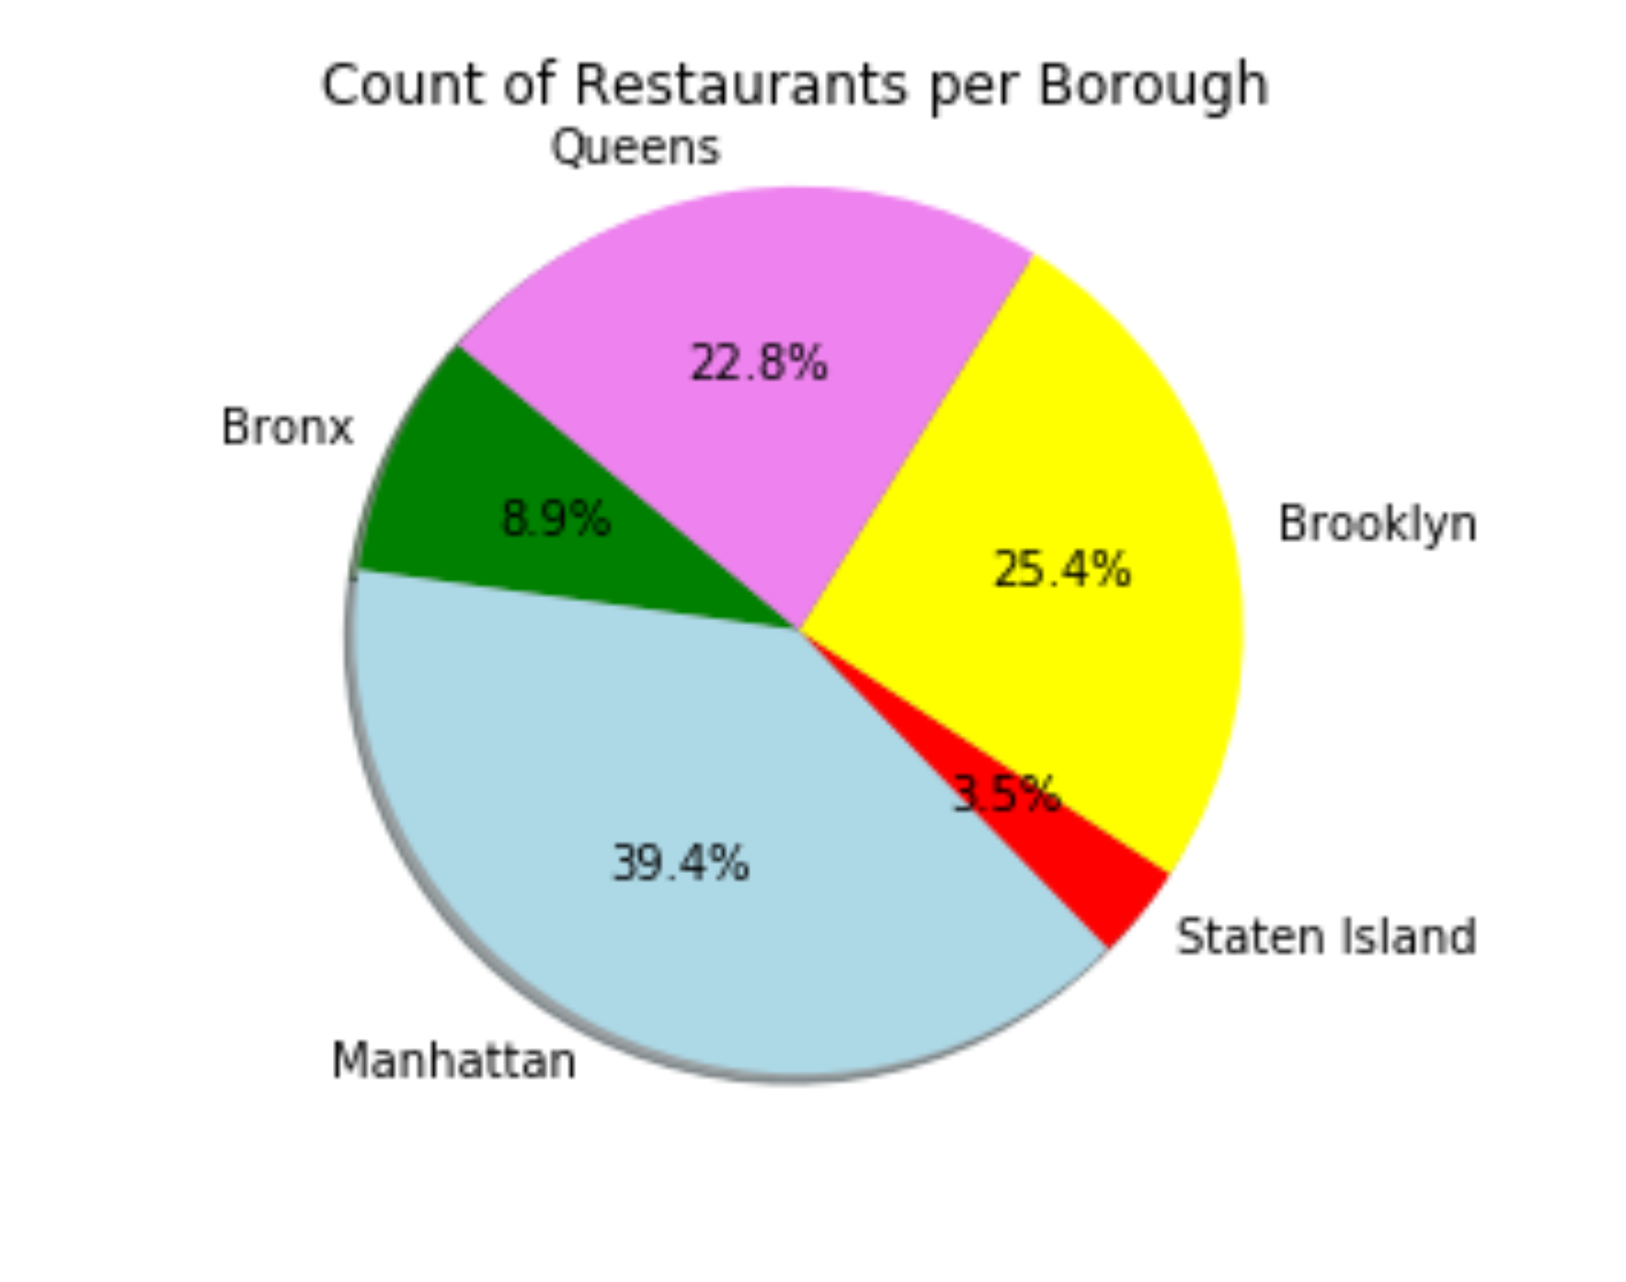
Count of Restaurants Per Borough
MANHATTAN 150,646
QUEENS 96,959
BROOKLYN 86,937
BRONX 34,145
STATEN ISLAND 13,277
Total: 381,964

Slide 12
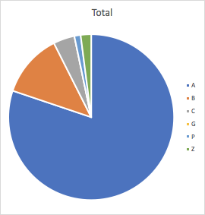
Total Grades Distribution*
A 80.17%
B 12.40%
C 4.16%
G 0.00%
P 1.22%
Z 2.05%
*Graph was made in excel

Slide 13
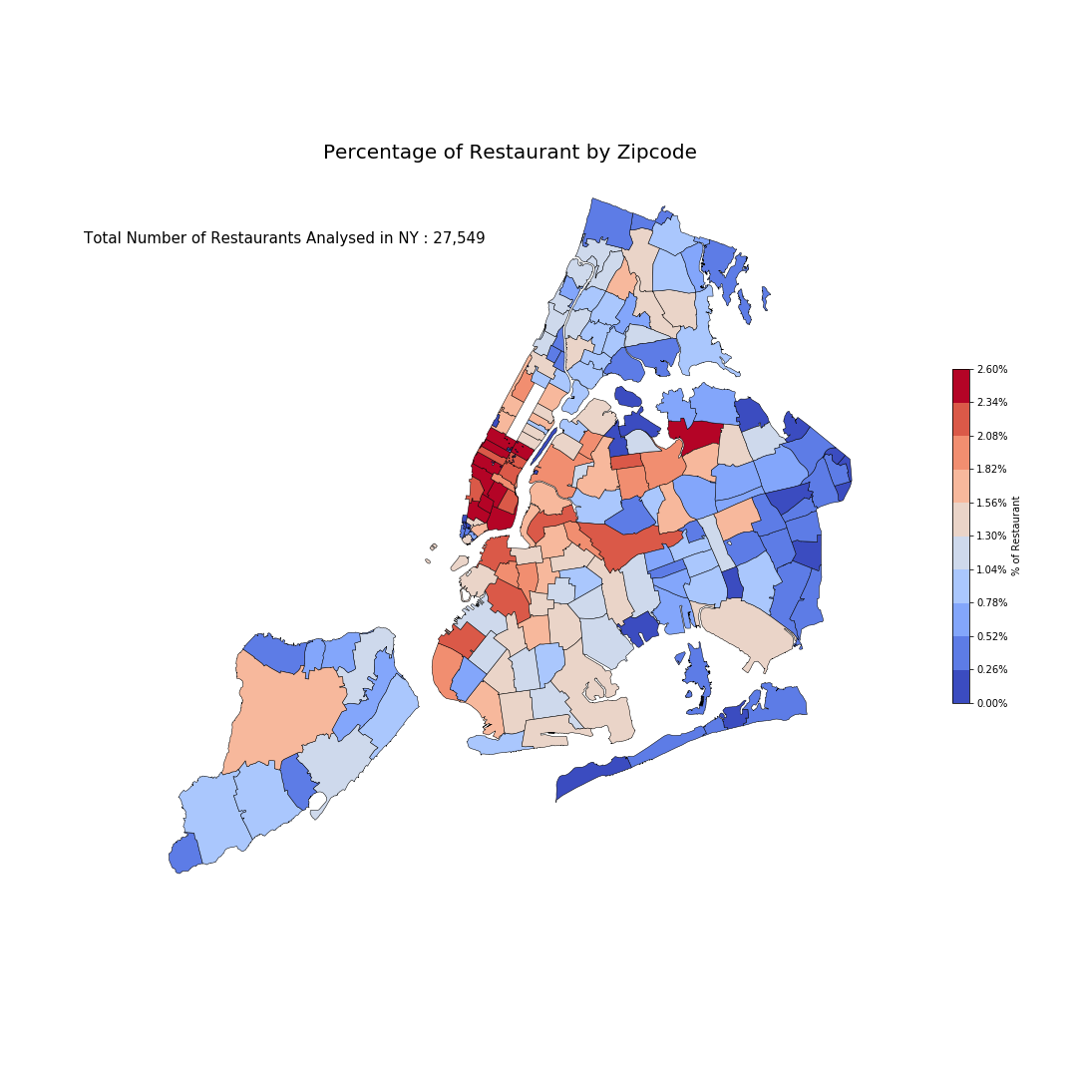
Density of Restaurants

Slide 14
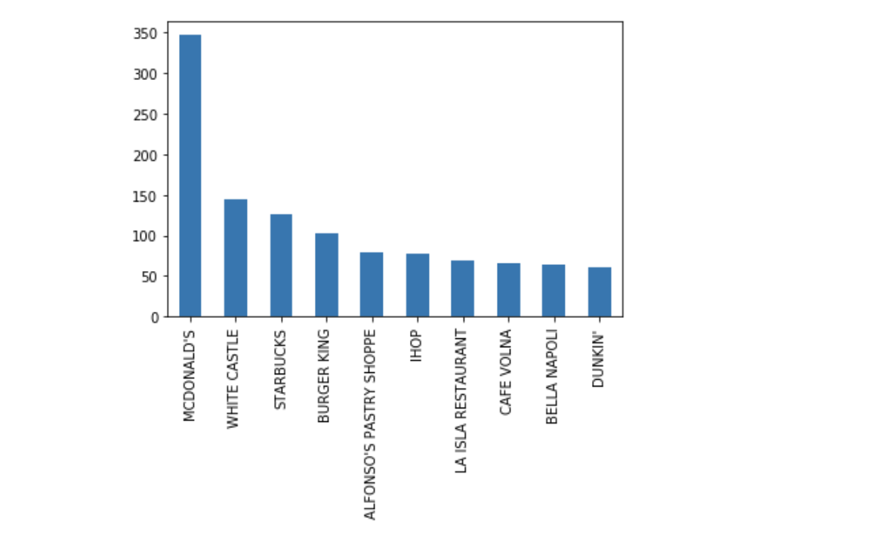
Top 10 Restaurants (Frequency)

Slide 15
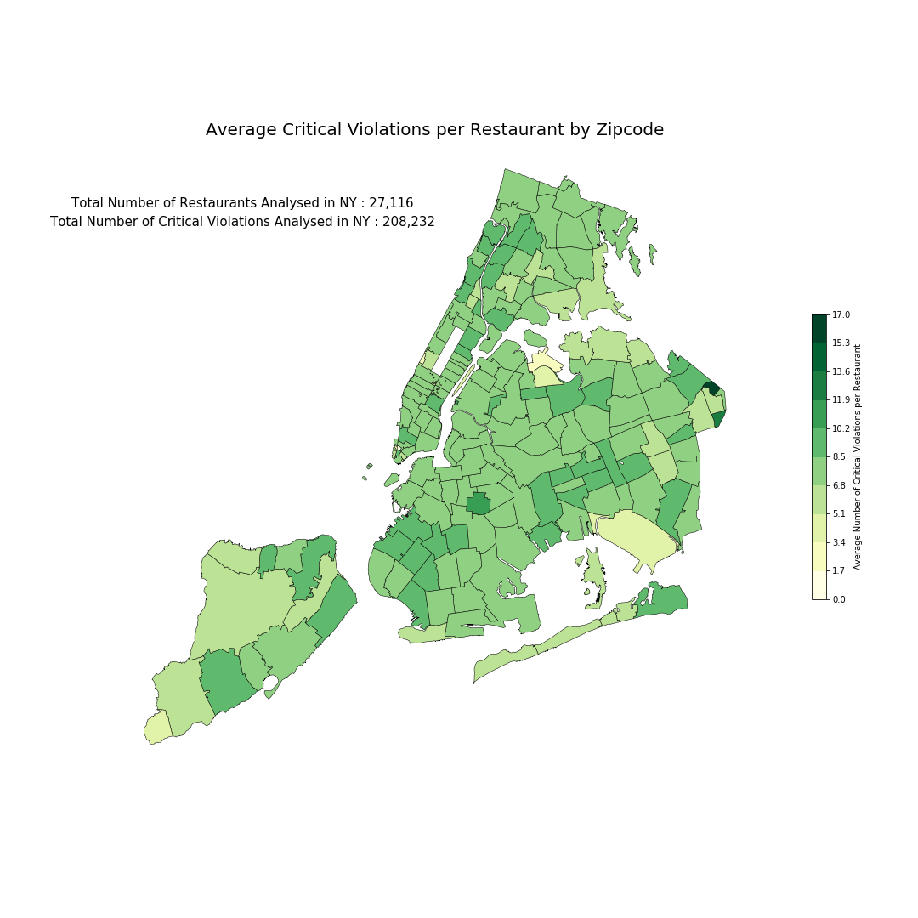

Slide 16
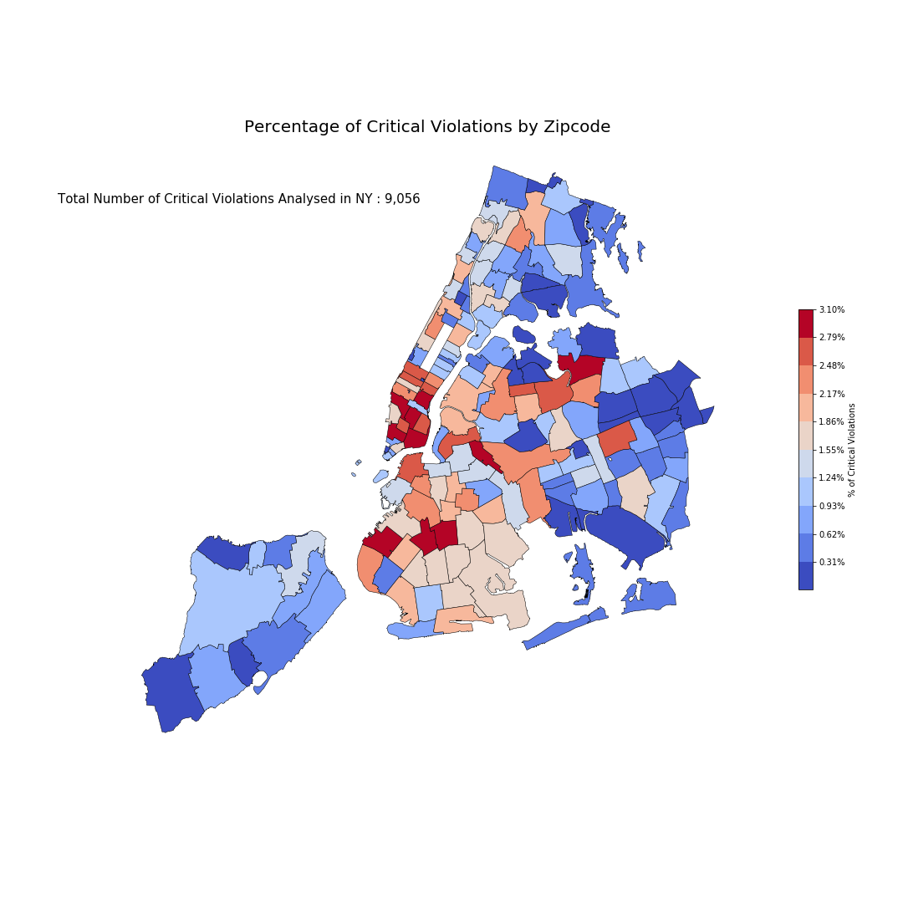

Slide 17
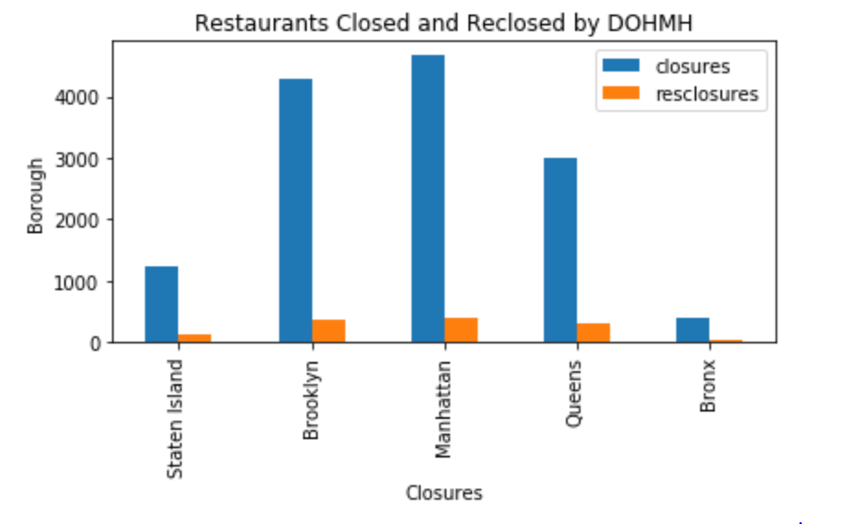
Closures by borough

Slide 18
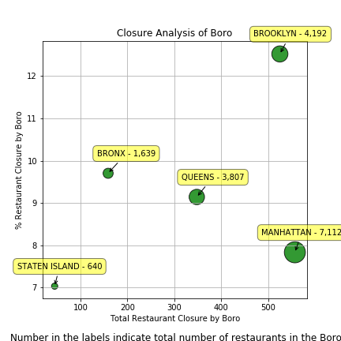
Closures by Borough

Slide 19
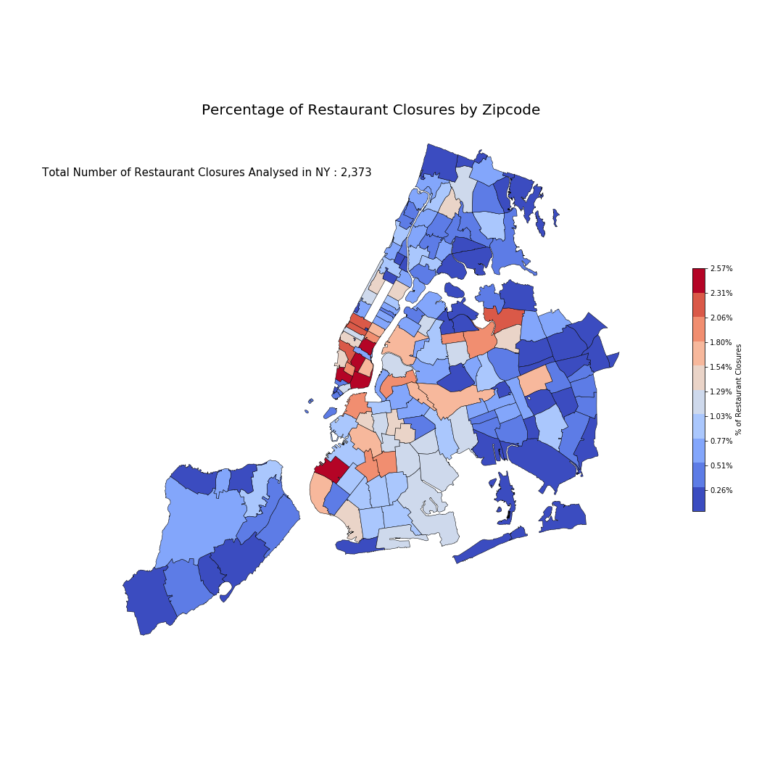
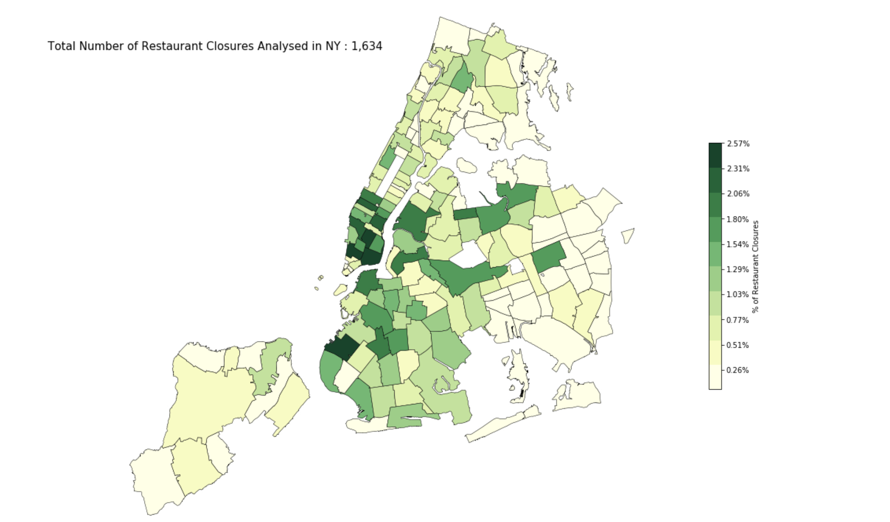
Percentage of Closures by Zip Code

Slide 20
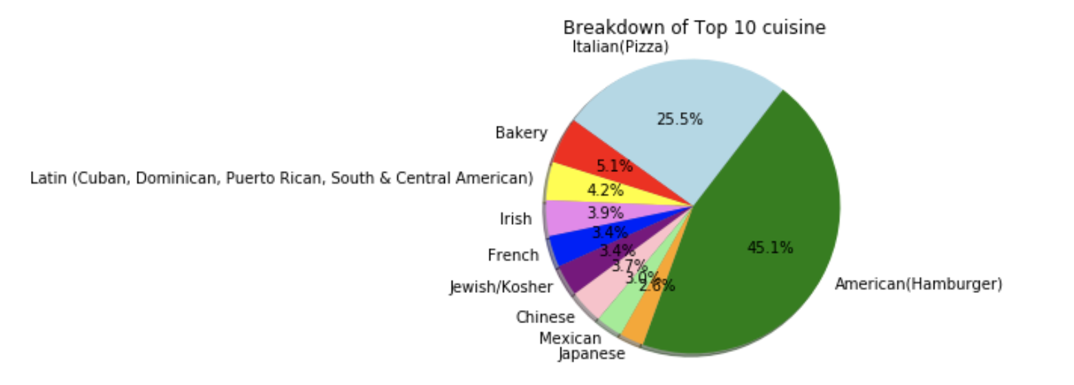
Breakdown of Top 10 cuisines

Slide 21
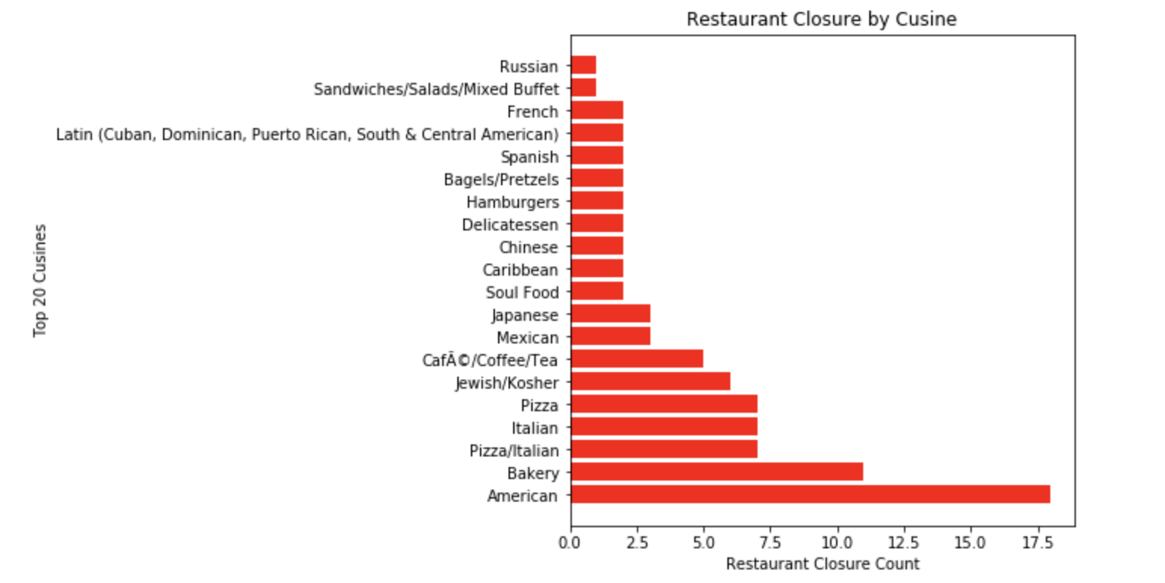
Closures by cuisines (Top 20)

Slide 22
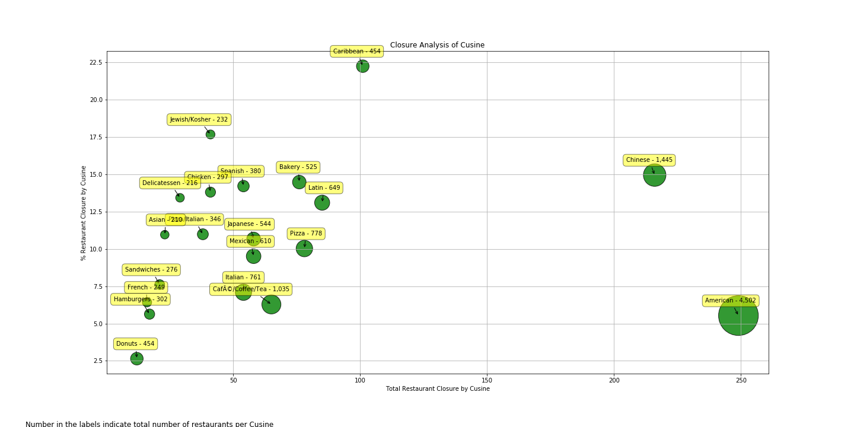
Closures by cuisine and borough

Slide 23
Findings
From the analysis we can infer the following:
American restaurants and bakeries had the highest inspection closure ratios of any other cuisine.
Caribbean and Jewish food eateries were at most risk of closure in their respective cuisines.
Manhattan and Brooklyn had the highest closures and repeat closures respectively.

Slide 24
Post Mortem
Difficulties:
Large data file we had to create a smaller dataset that showed 10K restaurants vs 400K when practicing
Binning Cuisine Types
Heatmaps were very difficult to create, and we had to use GeoPandas
Switching from smaller practice sets to large data sets created a slew of errors that had to be fixed a second time.

Slide 25
Post Mortem Cont.
If we had more time we would have investigated the following:
Are restaurants in ethnic enclaves more likely to be closed?
Why did more inspections/closures happen under Di Blasio vs Bloomberg?
Is there a policy change that lead to more ramp up inspections?
Investigate seasonality, are there more closures in summer vs winter?
Do chain restaurants perform better than mom and pop restaurants?
Is there a correlation on date of inspection and when restaurant receiving new inventory?
We build an API command to call up the restaurant grade for a restaurant input by the user.

Slide 26
Thank you
Q+A

Slide 27


